Slide 1
Work Documentation (Query Answering Model, SEBI Net, BERT)
Deepti Saravanan

Slide 2
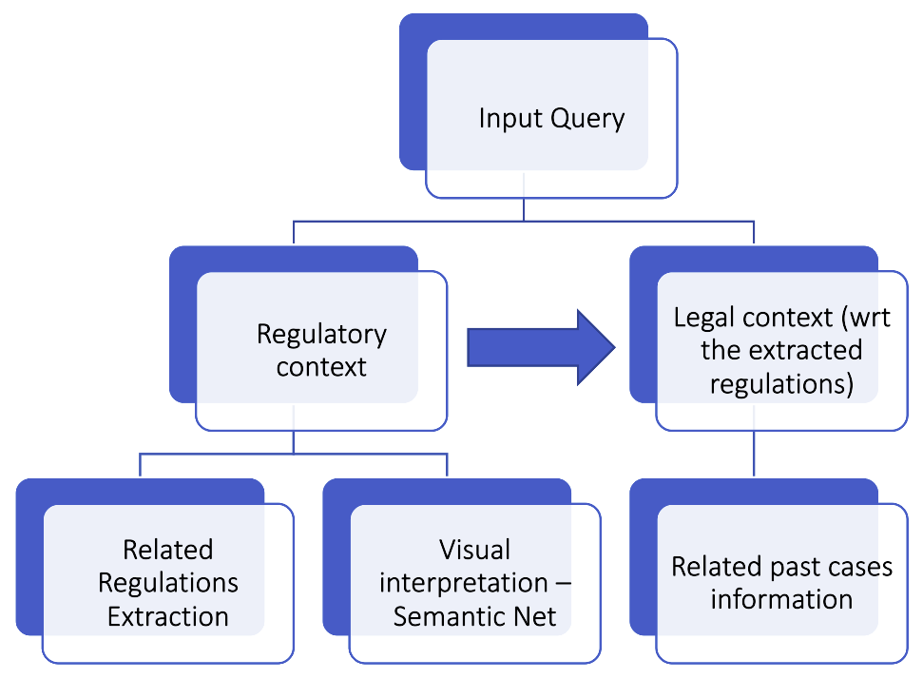
Query Answering Model (Ongoing)
Regulatory Component:
Presents regulations as answers along with their semantic and structural relationships with other related regulations.
Legal Component:
Presents past legal cases and contexts corresponding to these regulations.

Slide 3
SEBI Semantic Net
PROBLEM STATEMENT: Represent regulations as graphs and represent the semantic relationships between them by connecting the corresponding graphs.
MOTIVATION:
Semantic Analysis of regulations to identify similar patterns, contexts, purposes and relationship between the legal cases involving these regulations.
Regulatory Component of the query answering model.

Slide 4
Static Semantic Analysis - Challenges
Broader Context - The interrelations between regulations is highly complex that profiling clusters may become ambiguous due to intersections of clusters formed.
Noisy Data - The queries raised to the model will specify the specific context of origin of the same. Given this context, a few of the regulations in the clusters where the answers are present may become noisy and hence affect accuracy.

Slide 5
Proposed Work – Dynamic Semantic Net The proposed model overcomes the challenges by adapting to dynamic contexts specified by the input queries. Based on these contexts in focus, the regulations are sampled, semantically analyzed and presented as graphical output.
Query Specific – Defines the context
Semantic Analysis in Focus – Clustering of regulations
2 Step Process:
Step1: Related regulations retrieval
Step2: Two layered semantic net creation
Layer 1 : Regulations relationship via common phrase/subtle semantics heuristics
Layer 2 : Detailed network of interplay of subjects and objects

Slide 6
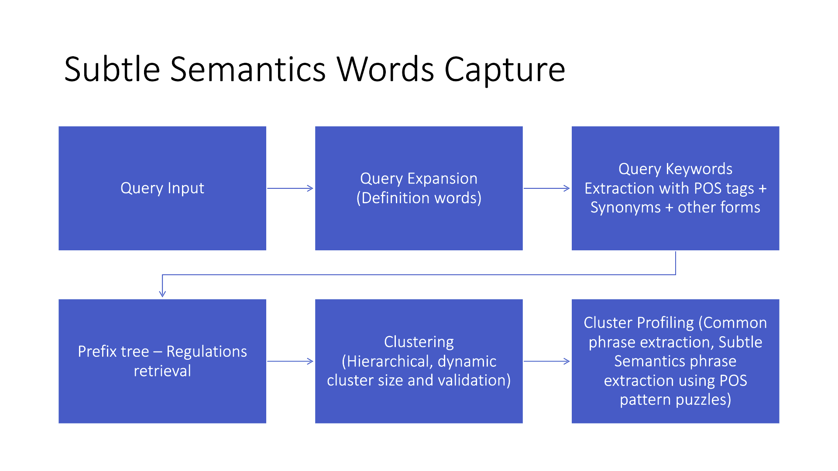
Step 1: Regulations Retrieval

Slide 7
Workflow Explained
The context is defined from the processed input query. The query is processed in two steps. First, the query is expanded by identifying and adding the SEBI definitions of the definition words present for a broader context. Following this, keywords are extracted, along with their WordNet synonyms and other POS forms to form the context-defining tokens. Regulations with atleast one of these tokens are considered to be related to the query. These related regulations are extracted with the help of Prefix Tree Mechanism.
The final sampled regulations obtained are then clustered hierarchically where the number of clusters are dynamically validated. Within each cluster, the common phrases between pairs of regulations are identified to establish the contextual relationships between them.
In focus, these regulations are further sampled based on the degree of similarity exhibited. These very closely related regulations are observed to show subtle differences based on atleast one of the semantic heuristics proposed (next slide).
These semantic heuristics are captured with the help of thePOS tag patterns and sequences exhibited by the regulations with the help of the regulation proximity model

Slide 8

Subtle Semantics Heuristics
Similar Actions, Different Entities
One of the entities may be the specific form of the other, for example, Manager and Investment Manager. This pattern provides insight on the relationship between the actions performed by the entities, given the context.
Subset Relationship
A few regulations are a subset of other regulations. This defines a context-specific hierarchy for the entities involved in the parent and child regulations.
Fixed Source and Target Entities
Regulations may differ by the transactions between the same source and target entities.
Verb Synonyms with differing purpose
The verbs defining the main context of regulations share the same meaning but the purpose and scope of the context differs.
Shared references and conditions
Some regulations, though different with respect to the entities and actions defined, yet converge to the same reference Act. This helps in capturing the unique kind of semantic relationship exhibited by these regulations.

Slide 9
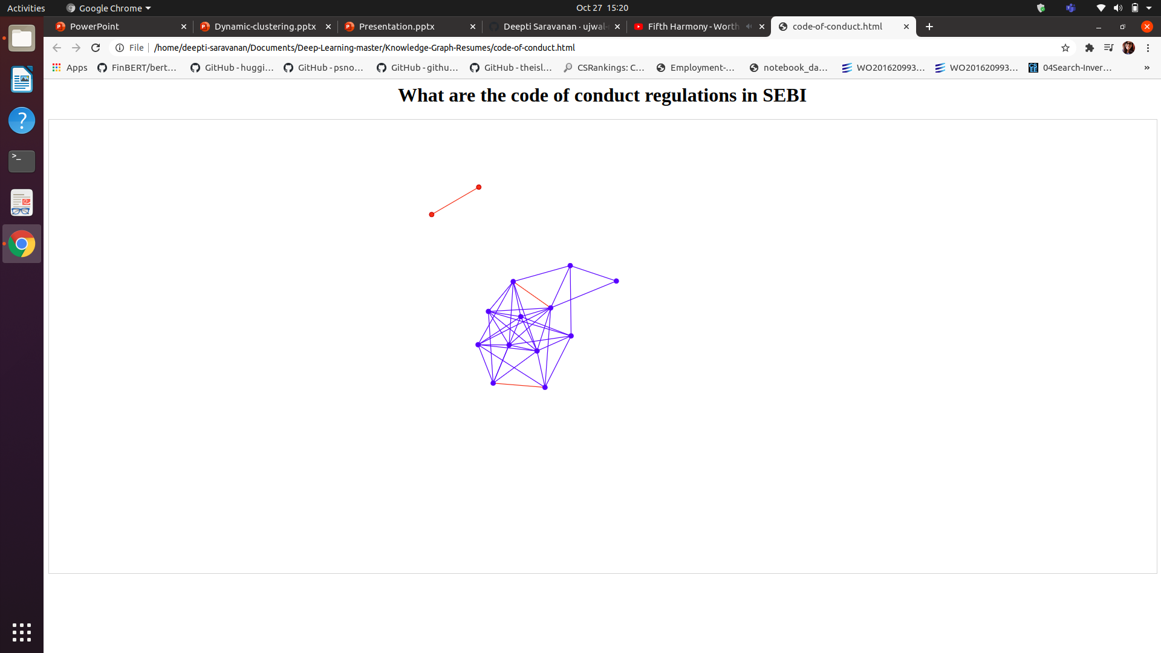
Step 2: Automated Semantic Net Creation
Layer 1 :
Nodes (Interactive)– Regulations
Edges (Interactive) – Subtle Semantic Phrases (if very closely related - red) | Common phrases (Otherwise – blue)
Degree of regulations - importance
Red Edges – Phrases that define the semantic heuristics exhibited by the regulations.
Blue Edges – Lower degree of similarity – no semantic heuristics exhibited. Edges define the common phrases that connect the regulations involved

Slide 10
Layer 2 (Ongoing)
The template created for regulations is used as the base.
The identified entity is the root node. The condition on the entity, if present, is highlighted with a different colour to alert its presence.
The action part of the regulations can be classified into two classes, based on the structural information.
Class 1 regulations are simple sentences while class 2 regulations are composed of multiple sub-points of short phrases or sentences.
The action part of the regulations are parsed accordingly based on the classes they fall under.
Like entities, the actions may also have conditions imposed on them. Such conditional sentences usually start with the word 'Provided' and these sub-graphs are colour-coded to acknowledge their presence.
Tricky parts – Node forking because of the presence of conjunctions and words that define semantic references like 'same'.
Regulation
Entity
Condition
Action
Sub-points
Single Sentence
Provided (Condition on action)
Points
Sentences

Slide 11
BERT
PROBLEM STATEMENT:
To create a base language model that can be utilised for various higher-level applications.
MOTIVATION:
An all-rounder AI system specific to SEBI domain that can understand legal semantics for predictive analytics.

Slide 12
BERT - Challenges
Data (for pretraining)
Common Evaluation Metrics (For different types of legal documents)

Slide 13

Model Pretraining and Selection (Ongoing)
BERT-base (Regulations, case files, news articles)
Individual
Combinations – Solves the limited data issue
*FinBERT-pretrained (Regulations, case files, news articles)
Individual
Combinations
Evaluation Criteria – Model Selection
*FinBERT from the paper:
Y. Yang, M. C. S. UY, and A. Huang, “Finbert: A pretrained language model for financial communications,” 2020.

